Slide 1
Image Captioning and Speech Recognition using NLP
Group Members:
Ali shah - 11518121
Nithish Kumar Boggula -11559328
Aditya Kapilavai - 11594174

Slide 2
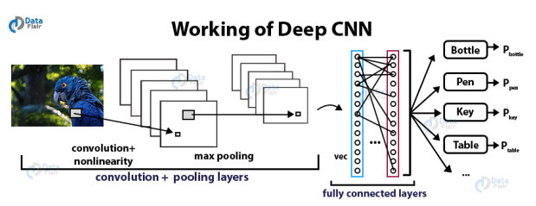
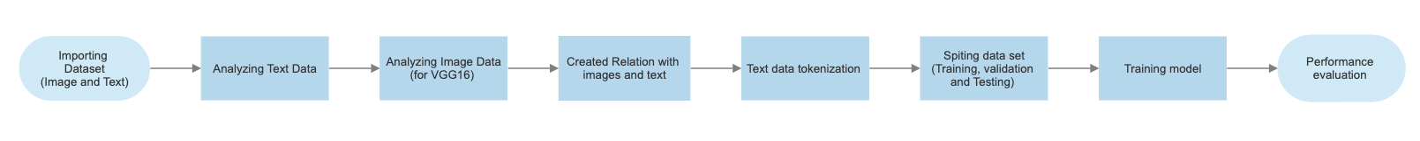
Workflows and architecture
First diagram represents the working of Deep CNN architecture which is utilized in our code.
Second diagram show workflow of our code with the detailed steps involved in getting best results

Slide 3
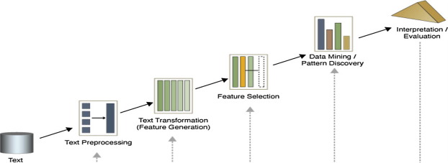
methodology
Importing the Text and image data to analyze the text and identify the most and least frequent words. Preprocessing the image to prepare for VGG16 model. We need to resize and normalize the pixels and convert the images to arrays. Creating a link between text and image and converting text into numerical by tokenizing. Split ,into train, validation and test sets. Evaluating the performance of the model on test set.

Slide 4
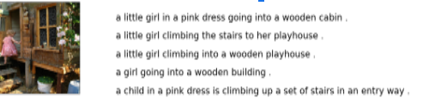
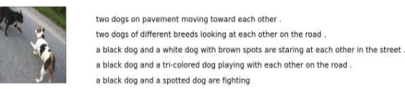
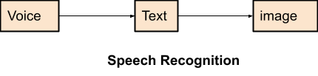
features
There are some features we have included in the already existing project that is adding speech to text and then text to image where a project has any one of the above-mentioned features. We are implementing these features to make it easy and navigate less.

Slide 5


tools
Google Colab for coding
Frameworks
Tensorflow
Keras
Numpy
Pandas
Hardware:
GPU is required for fast processing.

Slide 6
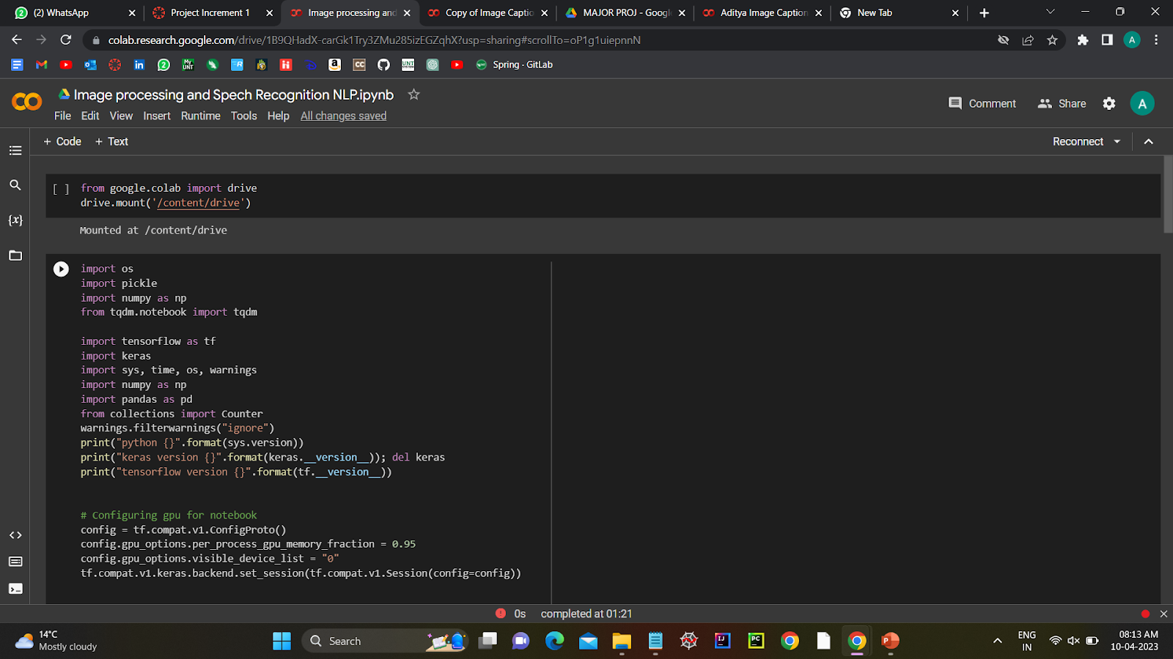
Implentation

Slide 7
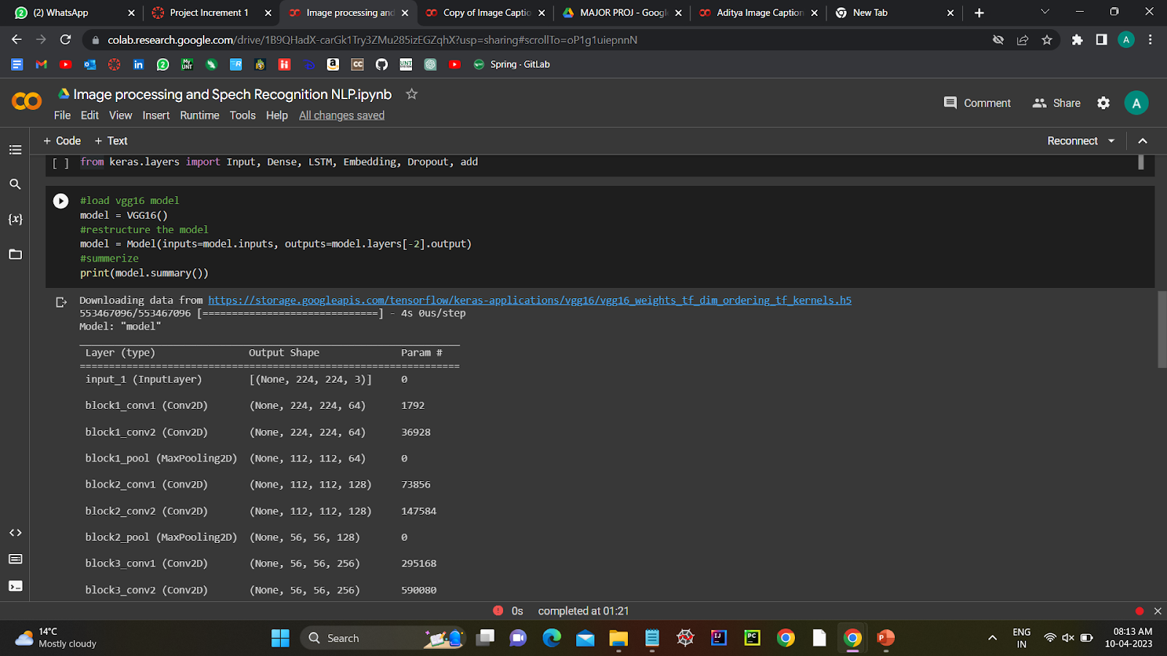
implementation

Slide 8
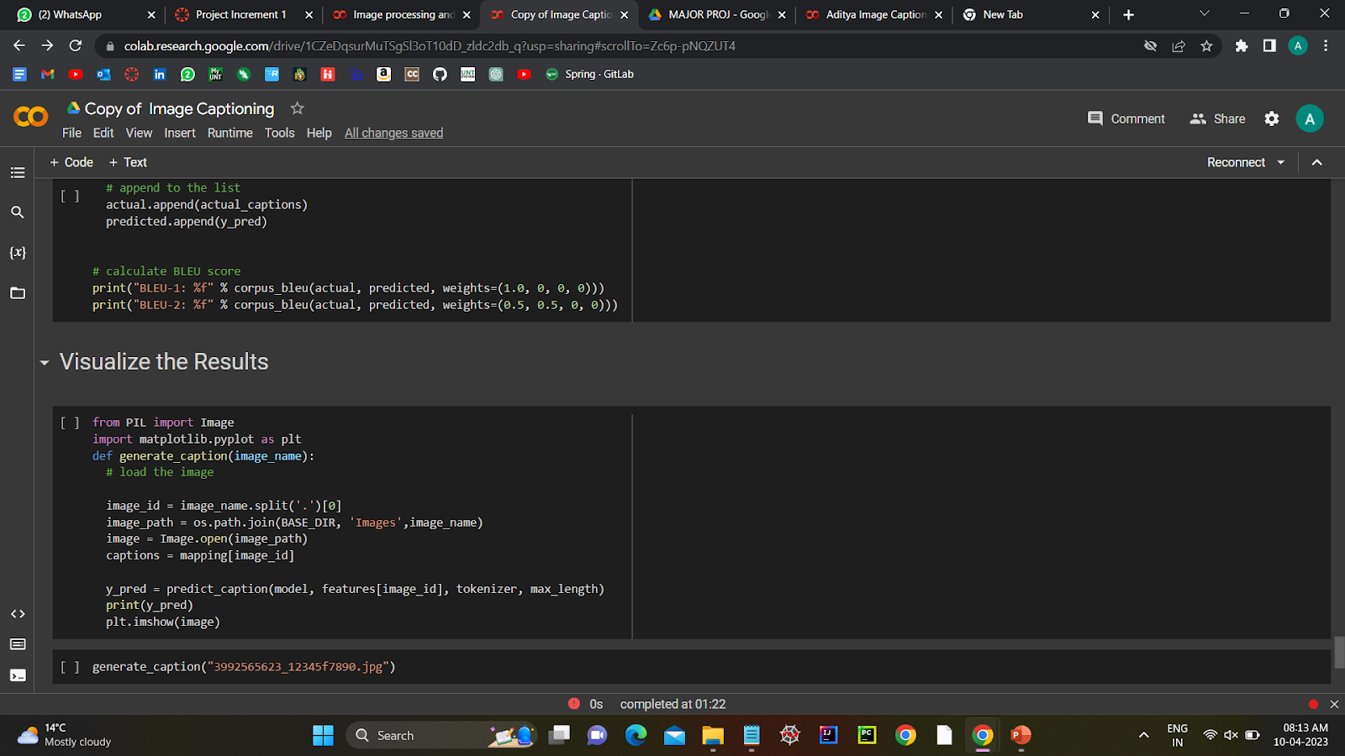
Implementation

Slide 9
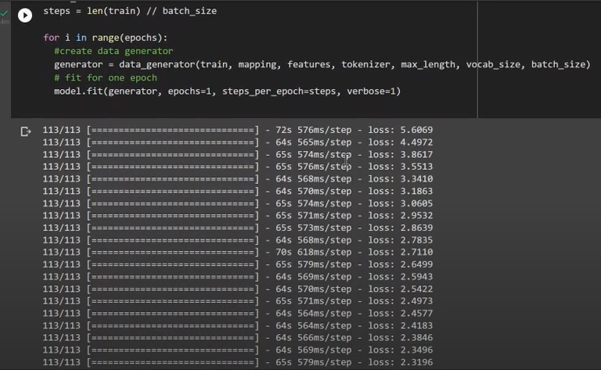
results
In image, we have determined the model fit with loss functions which indicates the losses when training started was 5.6 and then it decreased over the training iterations. We have trained are model with 113 step to get lower loss.

Slide 10
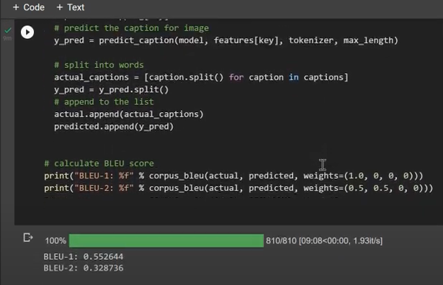
results
In this image, it shows that the how our model is performing. For evaluation we used BLEU which is a score metric for evaluating the quality of machine-generated text relative to a set of human-generated reference texts. In first evaluation it show that we got 55% of our text generate is good.
Note: (BLEU score range 0-1) higher the better

Slide 11
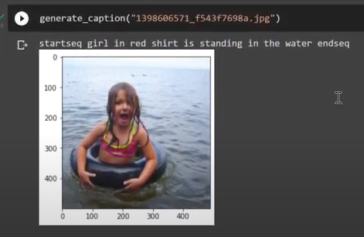
results
In this image, we have provided a image and on top caption is generated.
“Girl in red shirt is standing in the water”

